Slide 1

Fundamentals of Databases CBIO204

Slide 2


Database Project Medicine Inventory
Under the supervision of:
Dr. Mohamed Mahmoud ElSayeh
Under the supervision of the teaching assistant:
Dr. Esraa Magdy Anwar
Prepared by:
Youseif Hussein Farghaly

Slide 3
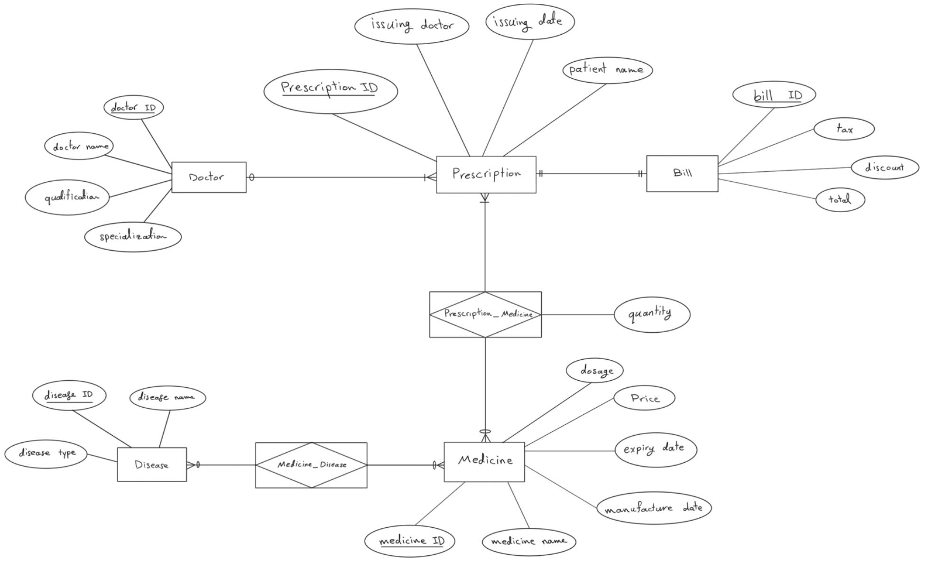
Entity–Relationship (ER) Model:

Slide 4
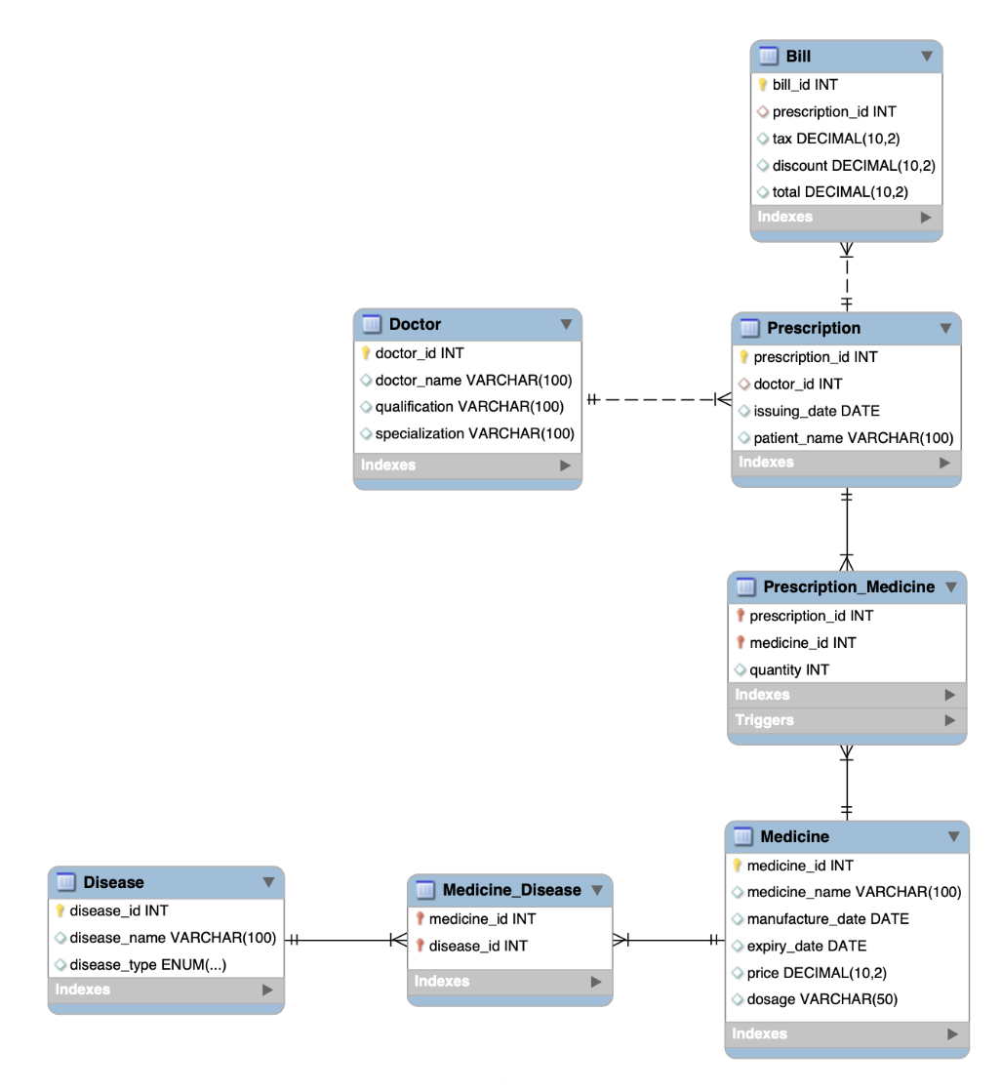
Diagram shows the relationships extracted from MySQL

Slide 5
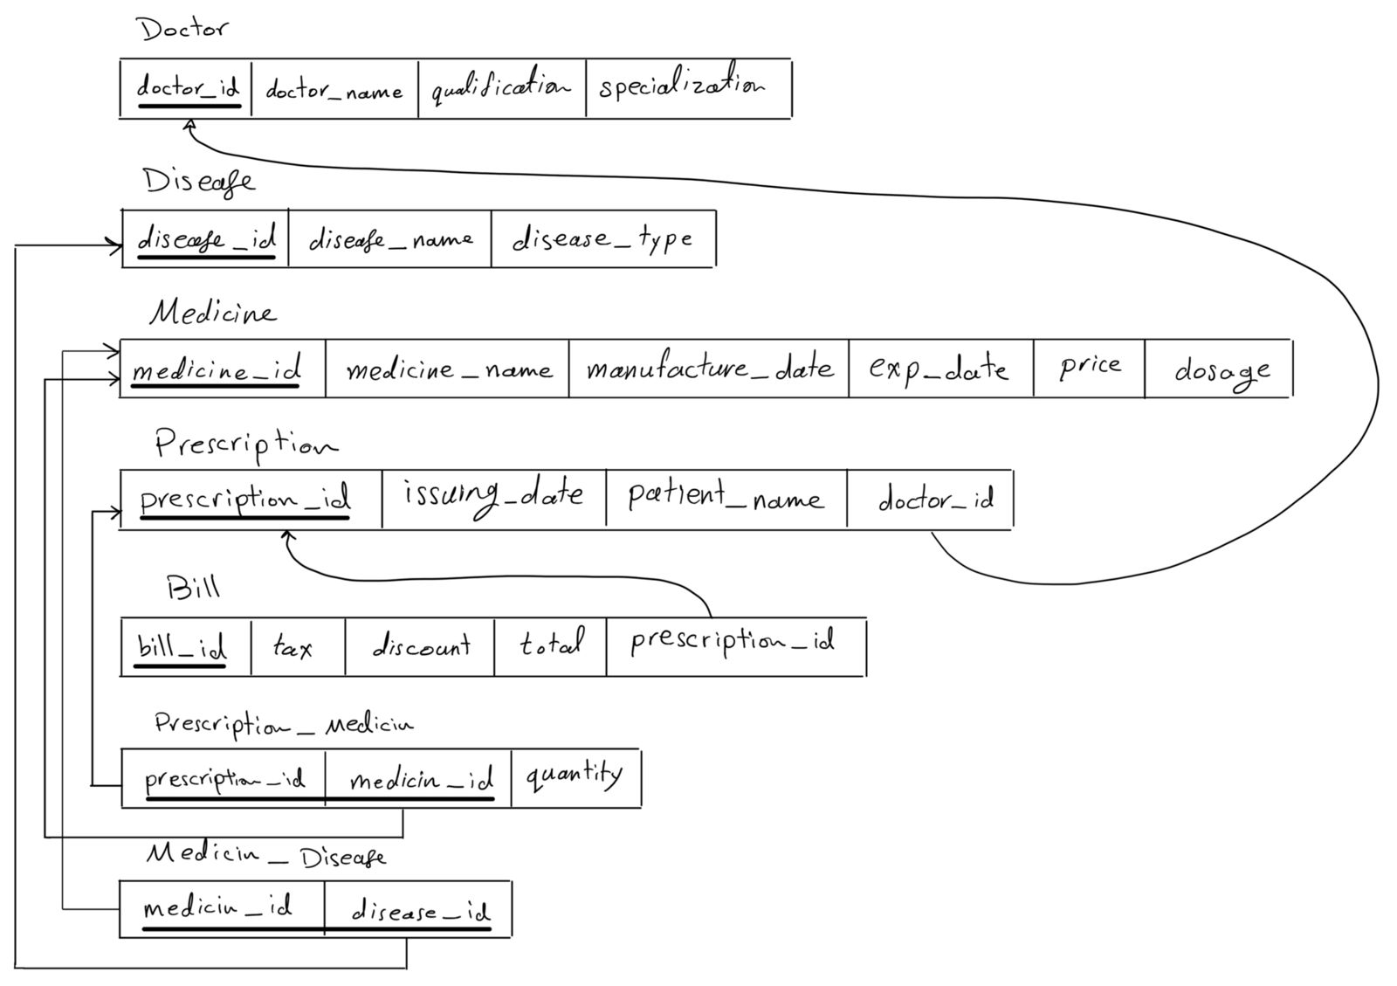
Logical Design:

Slide 6
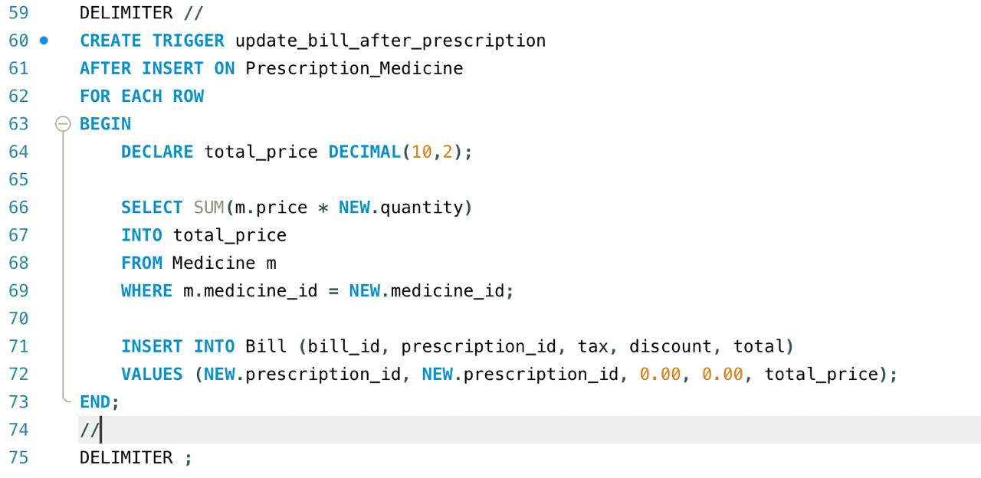
Automatically generate a bill after entering a prescription medication:
This is achieved by using a Trigger. It is a SQL code that is automatically executed when a specific event occurs (such as inserting, modifying, or deleting data in a table).

Slide 7
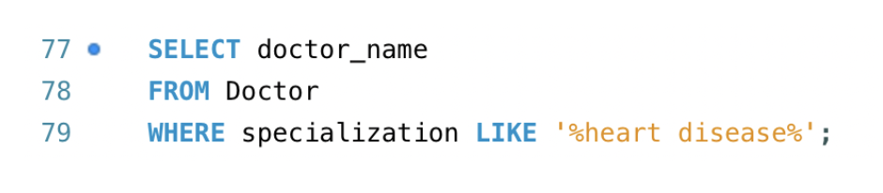
Simple and complex queries:
List the name of doctors whose specialty is heart disease:

Slide 8

Simple and complex queries:
List the deficiency diseases:

Slide 9
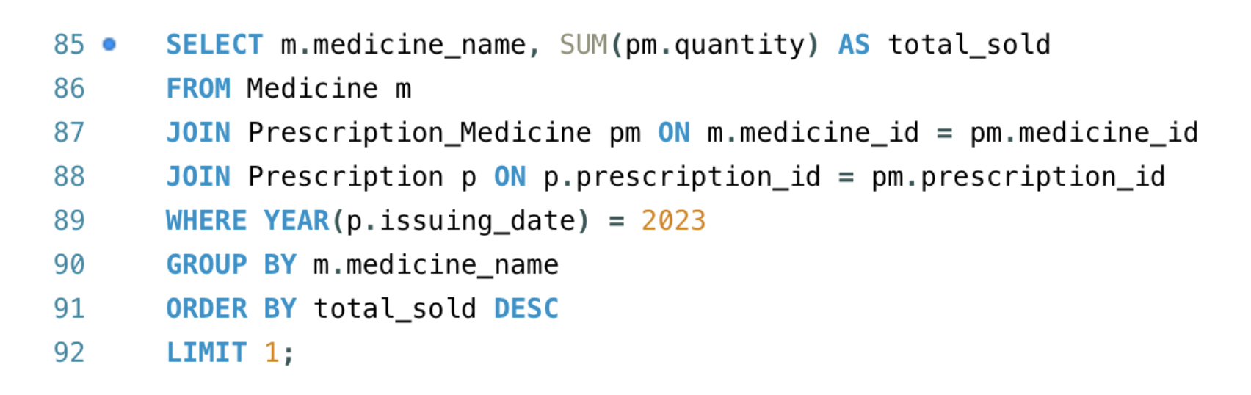
Simple and complex queries:
List the most medicine sold in 2023:

Slide 10


